Slide 1
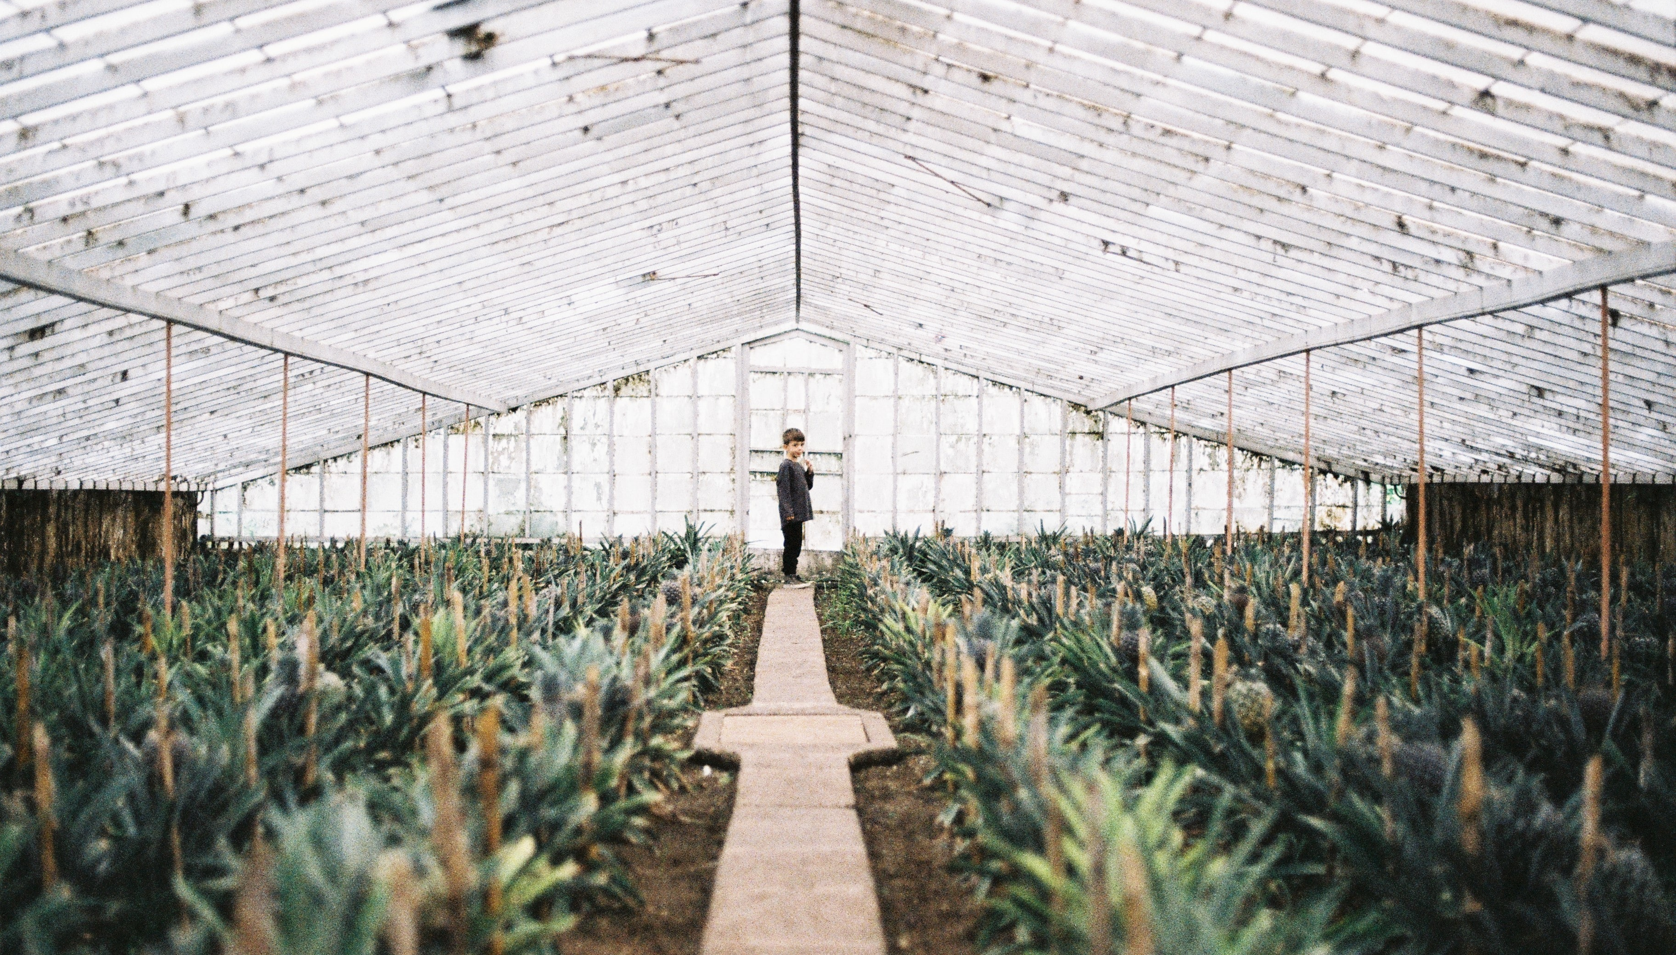
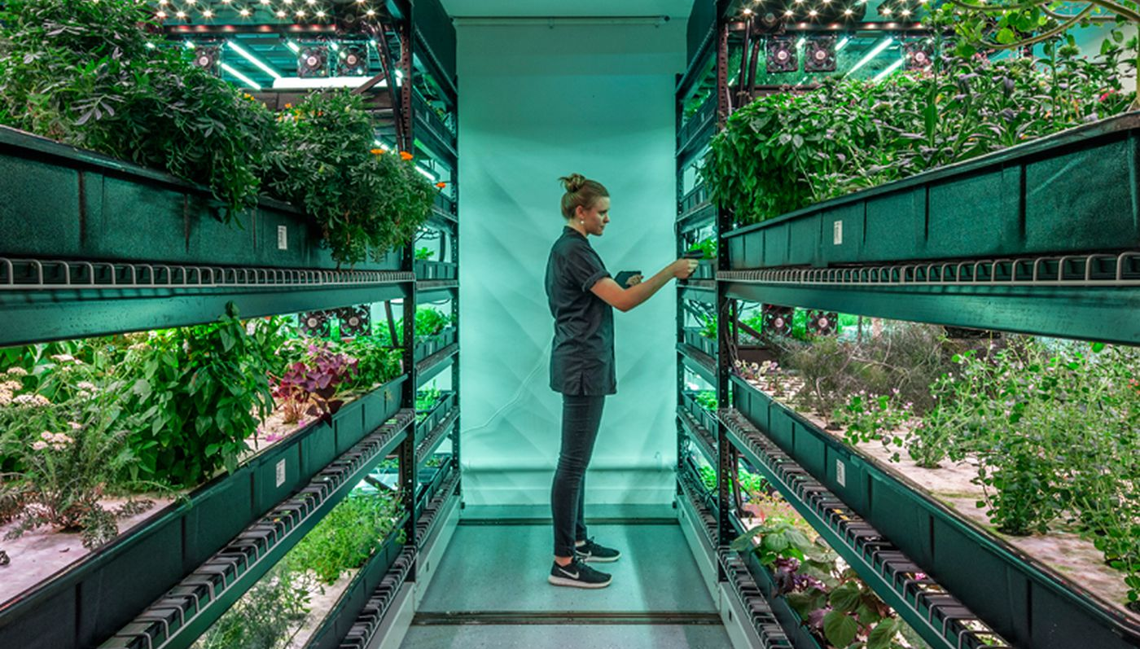
PATHFINDER FOR GREENHOUSE
MONITORING TEMPERATURE AND HUMIDITY.
TEAM 1

Slide 2


Team members
Ahmad Jaghasi
Harsh Patel
Robert Leedham
Sagar Kandel
Darrel Widjaja
Sheriff Oladunjoye
Hamad Al-Marri

Slide 3

WHY TEMPERATURE AND HUMIDITY IS IMORTANT?
Some of the importance of managing temperature and humidity in a greenhouse are:
Pests and disease control.
Stressed crops are more expectable to pests and diseases.
Mildew and mold can grow and spread quickly.
Poorly controlled humidity can lead to perfect breeding ground for disease.
Encourage crops performance for optimal growth.
Steering the crops to grow to a particular growth cycle leads to high yield.
Increase the ability of crops to take in extract nutrition for soli and environment leads to a tastier produce.
Corps that require a particular environmental condition can grow.

Slide 4
APPLICATION
The greenhouse crop we have decided to focuses on is strawberries.
Highly desired crop. They are widely used in desserts and dried breakfast cereal.
Juicy flavor deep scarlet colour and nutritional benefits.
Require cool temperature to flower.
Hot and humid temperature needed develop and constate their sweetness.

Slide 5
Example of a crop which is grown all year around in indoor greenhouse to meet the demand.
To increase their sweetness the daytime temperature needs to be 24 degrees Celsius during the day.
The night temperature needs to 13 degrees Celsius to develop flavor.
The humidity need to be 60% to 75%, as it benefits the nutrition of the fruit.
Good quality soil is needed to increase its calcium uptake and sunlight is needed for photosynthesis to develop the deep scarlet colour.
Temperature and humidity are importation to make sure that the crop can be grown all year around in an indoor greenhouse.

Slide 6
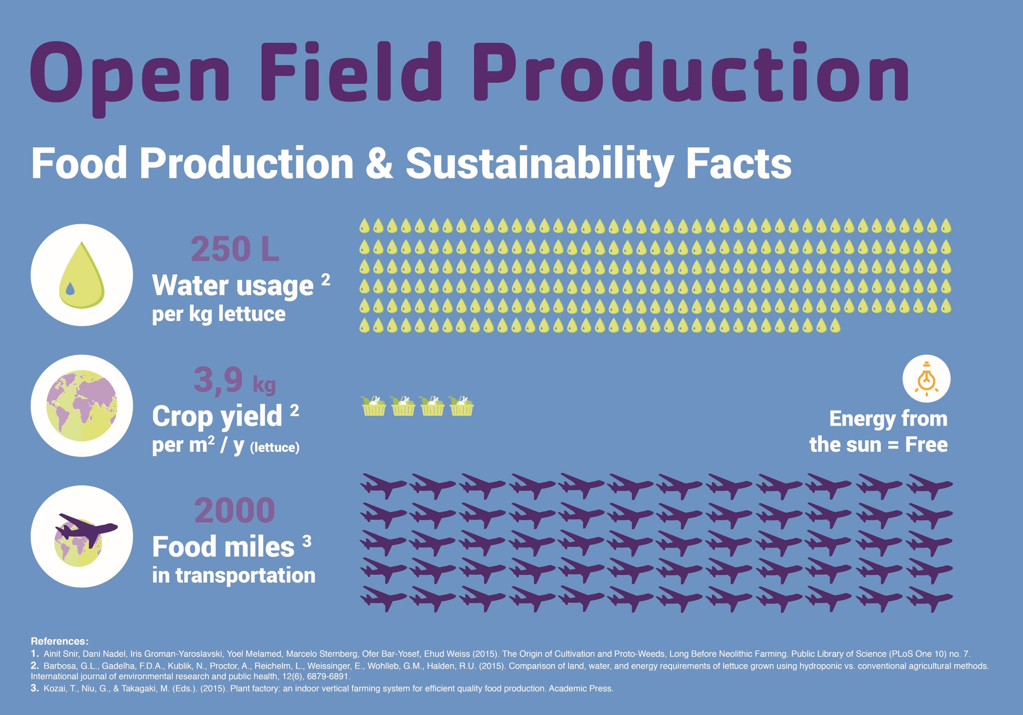
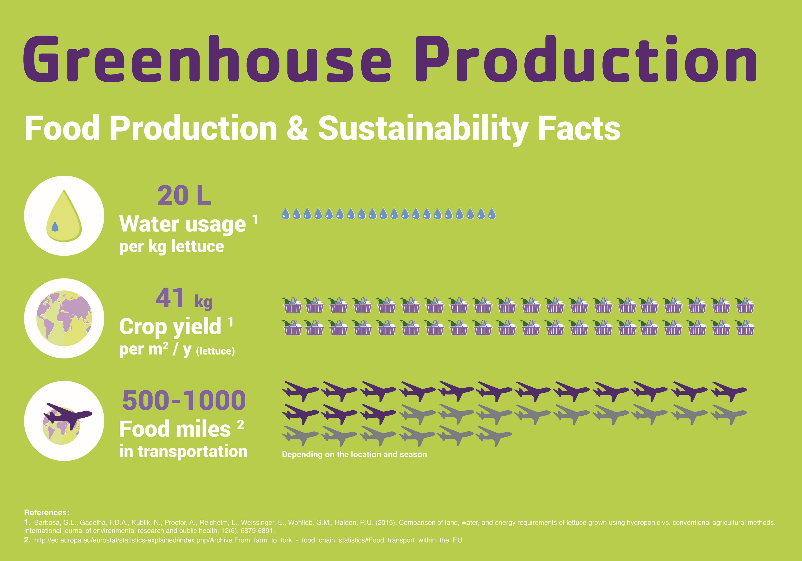
Notes:
Images from: https://www.eitfood.eu/blog/post/is-vertical-farming-really-sustainable

Slide 7
Capabilities of the Product
Now
Moving the car forward/ reverse in different speeds.
Stopping the car.
Steering the car left and right in different angels.
Later
Communicating with other sensors and peripherals (e.g. temperature and humidity).
Making the car its own decision on how to follow a specific path.
Sending and receiving data
Making an APP (Optional)

Slide 8
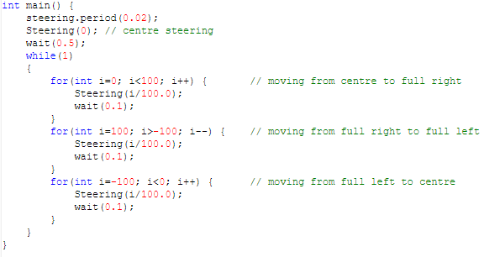

Slide 9
